Slide 1
THE INTERNET & WORLD WIDE WEB
Chapter 2

Slide 2

Chapter 2 Objectives
Discuss the history of the Internet
Describe the types of Web sites
Explain how to access and
connect to the Internet
Recognize how Web pages
use graphics, animation, audio,
video, virtual reality, and plug-ins
Analyze an IP address
Identify the steps required for Web publishing
Identify the components of a Web address
Explain the purpose of a Web browser
Explain how e-mail, FTP, newsgroups
and message boards, mailing lists, chat rooms,
instant messaging, and Internet telephony work
Search for information on the Web
Identify the rules of netiquette

Slide 3
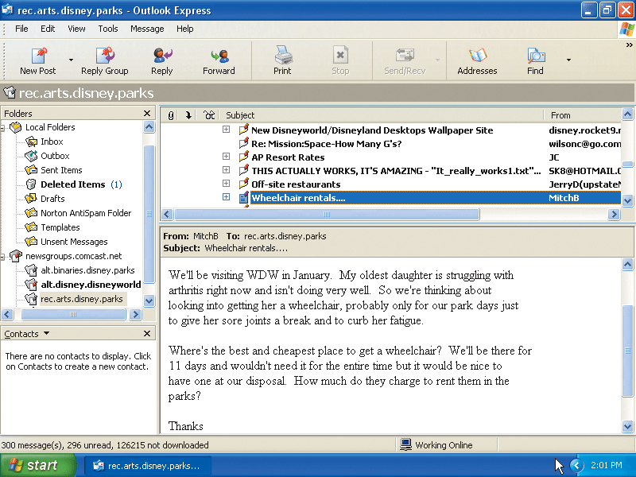
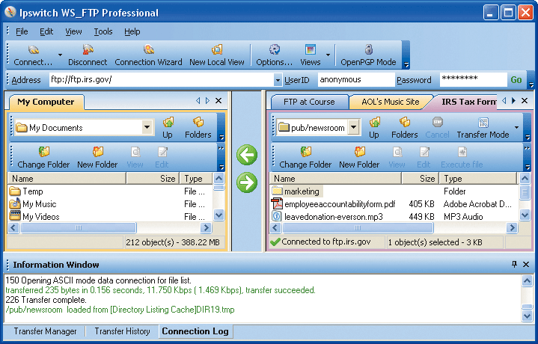
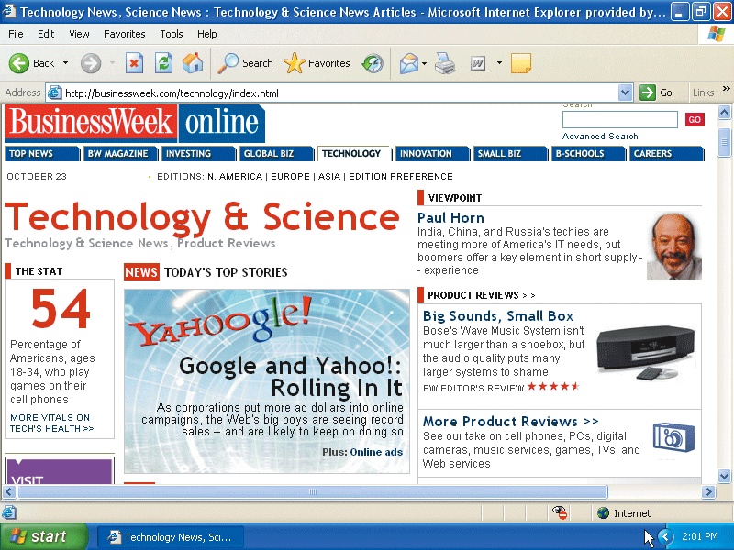
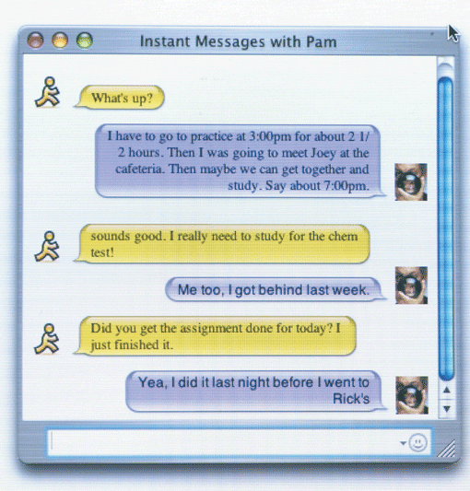
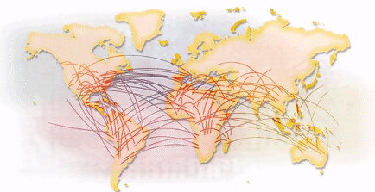
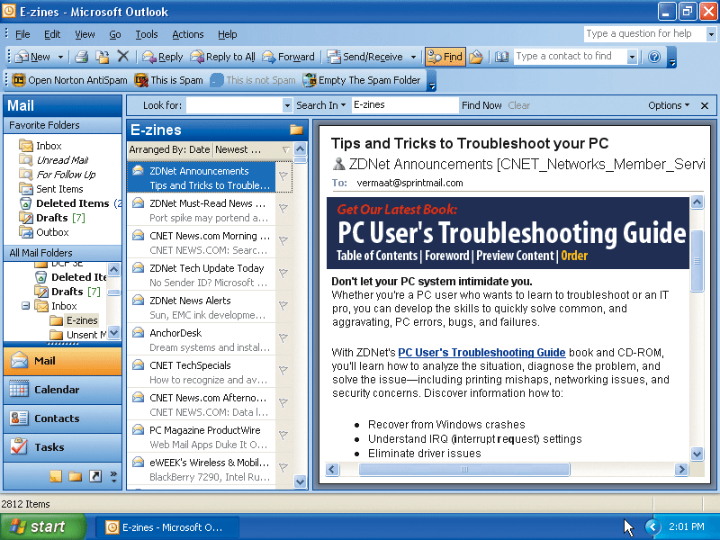
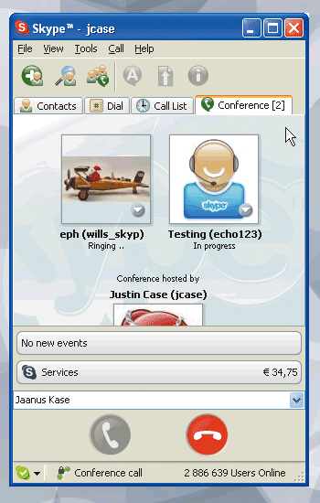
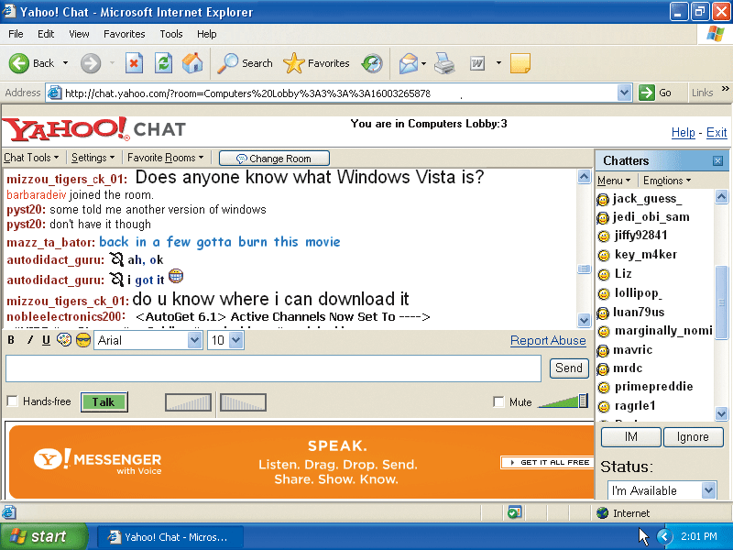
What are some services found on the Internet?
The Internet
p. 68-69 Fig. 2-1
Next

Slide 4
History of the Internet
How did the Internet originate?
ARPANET
Networking project by Pentagon’s Advanced Research Projects Agency (ARPA)
Goal:
To allow scientists at different locations to share information
Goal:
To function if part of network were disabled
Became functional September 1969
Next
p. 69

Slide 5
History of the Internet
How has the Internet grown?
Today
More than 350 million host nodes
1984
More than 1,000 host nodes
1969
Four host nodes
p. 69
Next

Slide 6
History of the Internet
Who controls the Internet?
  No onec—cit is a public, cooperative, and
  independent network
  Several organizations set standards
World Wide Web Consortium (W3C)
  Oversees research, sets standards and guidelines
  Tim Berners-Lee, director
Internet2 (I2)
  Internet-related research and development project
  Develops and tests advanced Internet technologies
p. 70
Next

Slide 7
How the Internet Works
How can you connect to the Internet?
Slow-speed
technology
High-speed
connection
Dial-up access
modem in your
computer uses a
standard telephone line
to connect to the Internet
Digital subscriber line (DSL),
cable telephone Internet
services (CATV), cable modem,
fixed wireless, and satellite modems
Connection must be established
each time you log on.
Slow but inexpensive
Connection is always on—
whenever the computer
is running
p. 70
Next

Slide 8
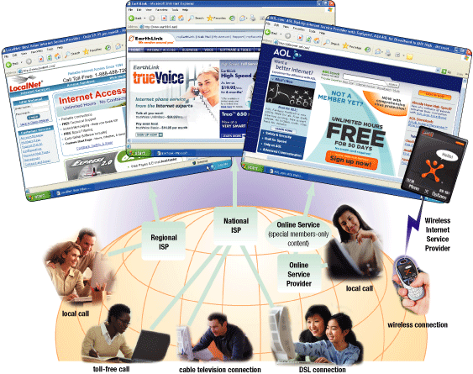
How the Internet Works
What are ways to access the Internet?
  ISP, Regional
  or National
  OSP (AOL and
  MSN, for example)
  Wireless Internet
  Service Provider
p. 71 – 72 Fig. 2-2
Next

Slide 9
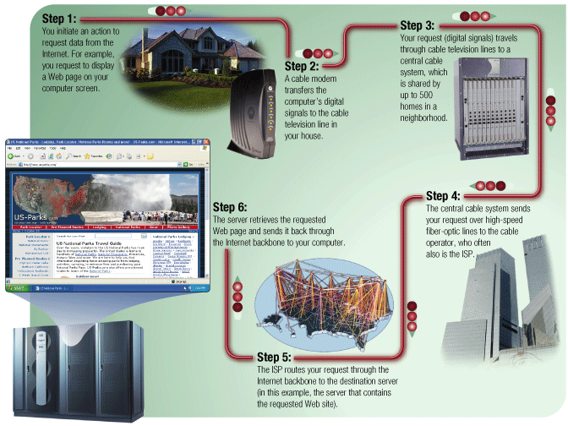
How the Internet Works
How might data travel the Internet using a
cable modem connection?
p. 73 Fig. 2-3
Next

Slide 10
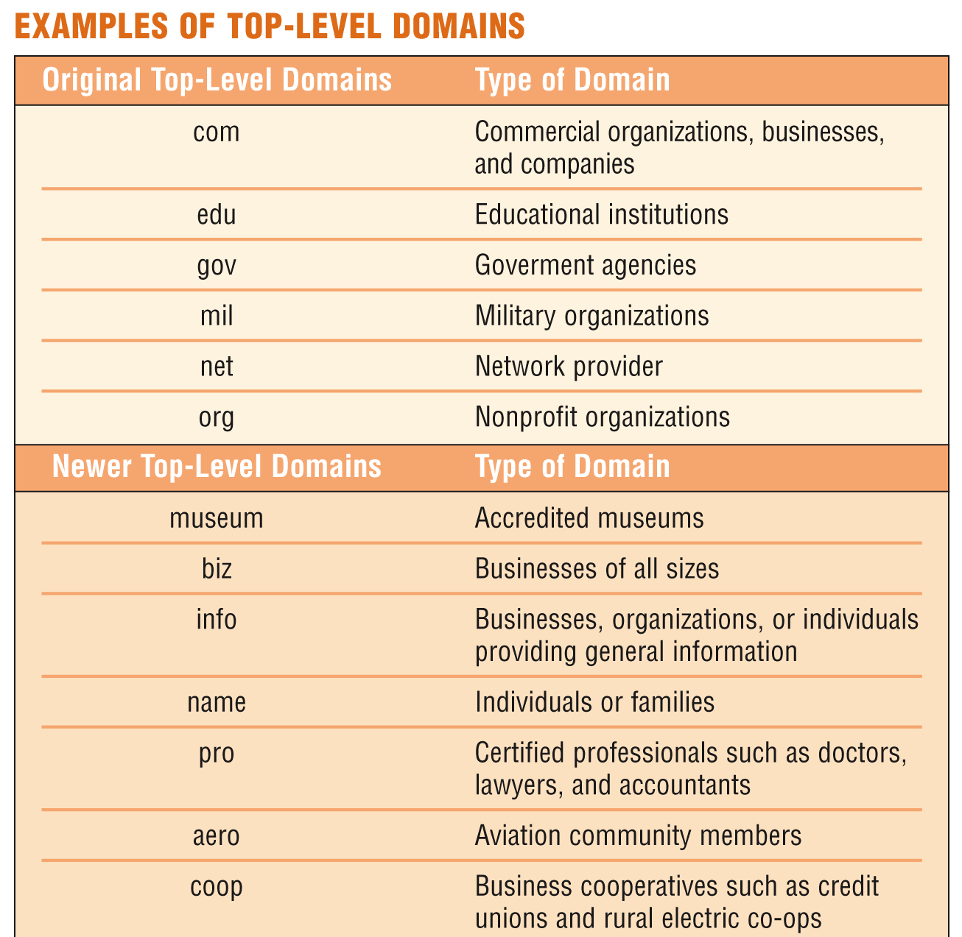
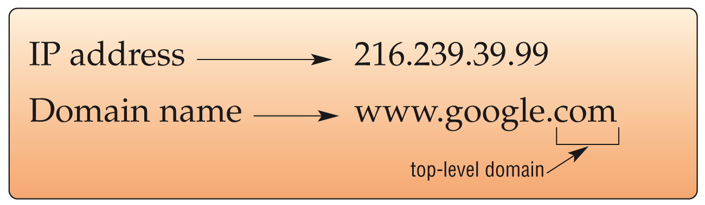
How the Internet Works
What is a domain name?
  Text version of Internet protocol (IP) address
    Number that uniquely identifies each computer or device connected to Internet
p. 73 - 74 Figs. 2-4 – 2-5
Next

Slide 11
The World Wide Web
What is the World Wide Web (WWW)?
A worldwide collection of electronic documents
Also called the Web
Each electronic document is called a Web page
Can contain text, graphics, sound, video, and built-in connections
A Web site is a collection of related Web pages
p. 75
Next

Slide 12
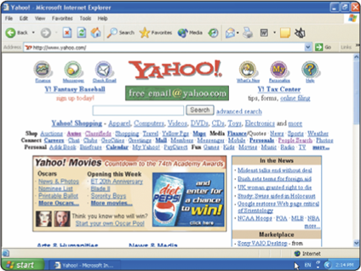
What is a Web browser?
  Program that allows you to view Web pages
Microsoft
Internet
Explorer
Netscape
Mozilla
The World Wide Web
Firefox
Opera
Safari
p. 75
Next

Slide 13
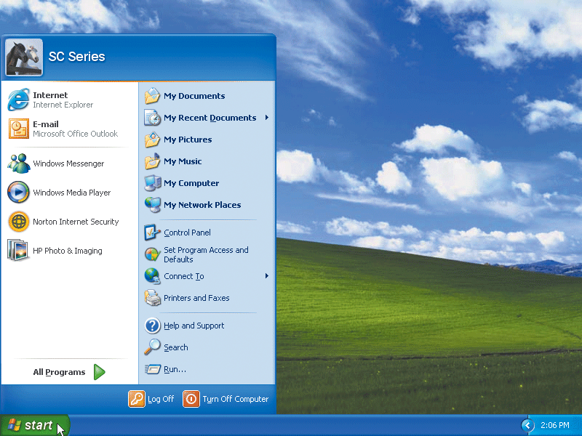
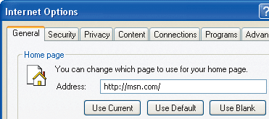
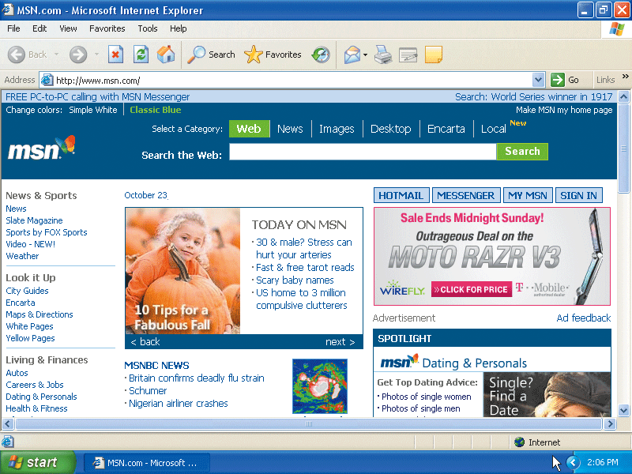
How does a Web browser display a home page?
Step 2.
Web browser looks up the home page setting
Step 3.
The Web browser communicates with the ISP’s server to retrieve the IP address. The IP address is sent to your computer.
Step 1.
Click the Web browser program name
The World Wide Web
Step 4.
The home page displays in the Web browser
p. 75 Fig. 2-6
Next

Slide 14
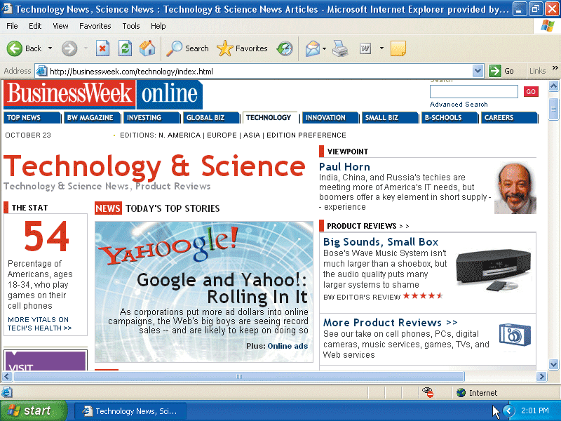
The World Wide Web
What is a home page?
  The first page that a Web site presents
  Often provides connections to other Web pages
p. 76 Fig.2-1a
Next

Slide 15

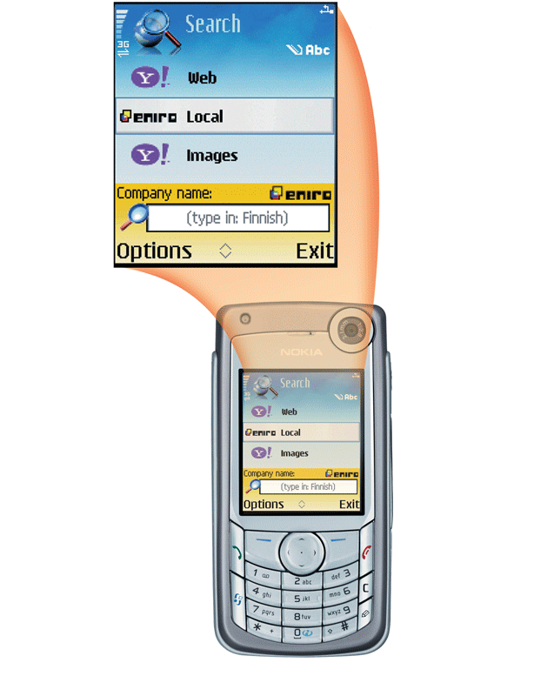
The World Wide Web
How do handheld computers and cellular telephones access the Web?
  Use a microbrowser that displays Web pages that contain mostly text
  Must be Internet-enabled
p. 76 Fig. 2-7
Next

Slide 16

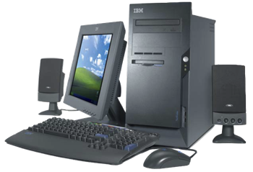
The World Wide Web
What is downloading?
  The process of a computer receiving information
  Depending upon connection speed, downloading can take from a few seconds to several minutes
p. 76
Next

Slide 17
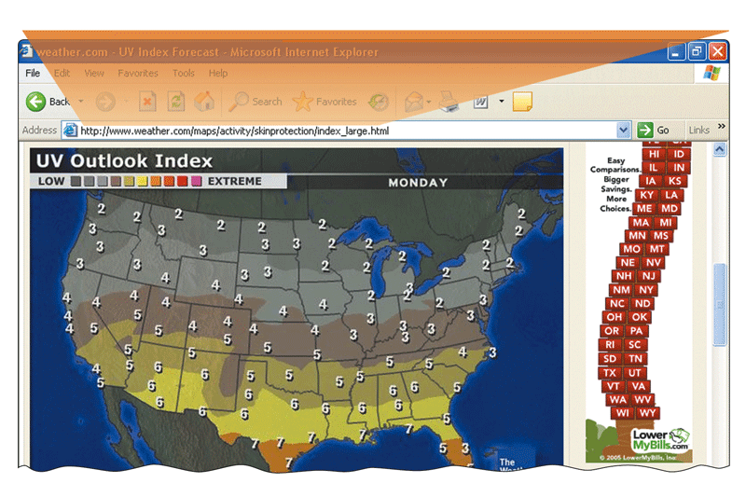
The World Wide Web
What is a URL?
  Unique address for a
  Web page
      A web server delivers the Web page to your computer
p. 76 Fig. 2-8
Next

Slide 18
The World Wide Web
What is a link?
  Built-in connection to another related Web page location
    Item found elsewhere
    on same Web page
    Different Web page
    at same Web site
    Web page at a different
    Web site
Next
p. 77

Slide 19
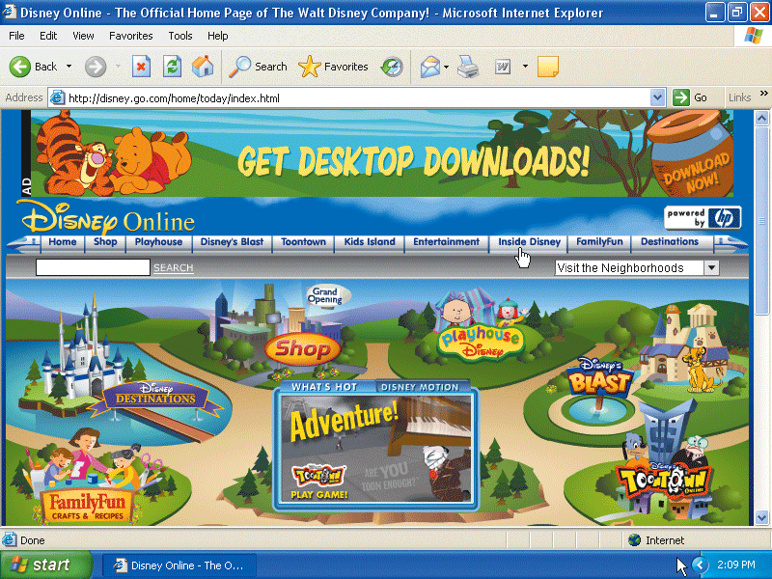
The World Wide Web
How can you recognize links?
  Pointer changes to a small hand
  when you point to
  a link
  A link can be text
  or an image
  Text links are
  usually underlined
  and in a different
  color
p. 77 Fig. 2-9
Next

Slide 20
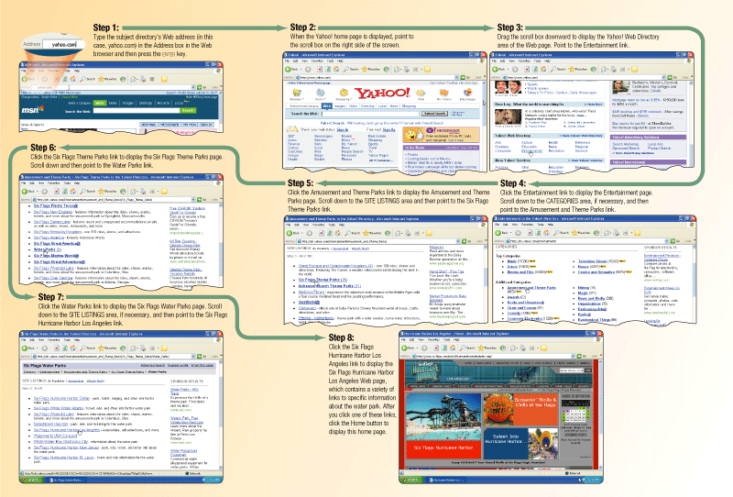
The World Wide Web
What is a subject directory?
  Search tool with organized set of topics and subtopics
  Lets you find information by clicking links rather than entering keywords
p. 78 – 79 Fig. 2-11
Next

Slide 21
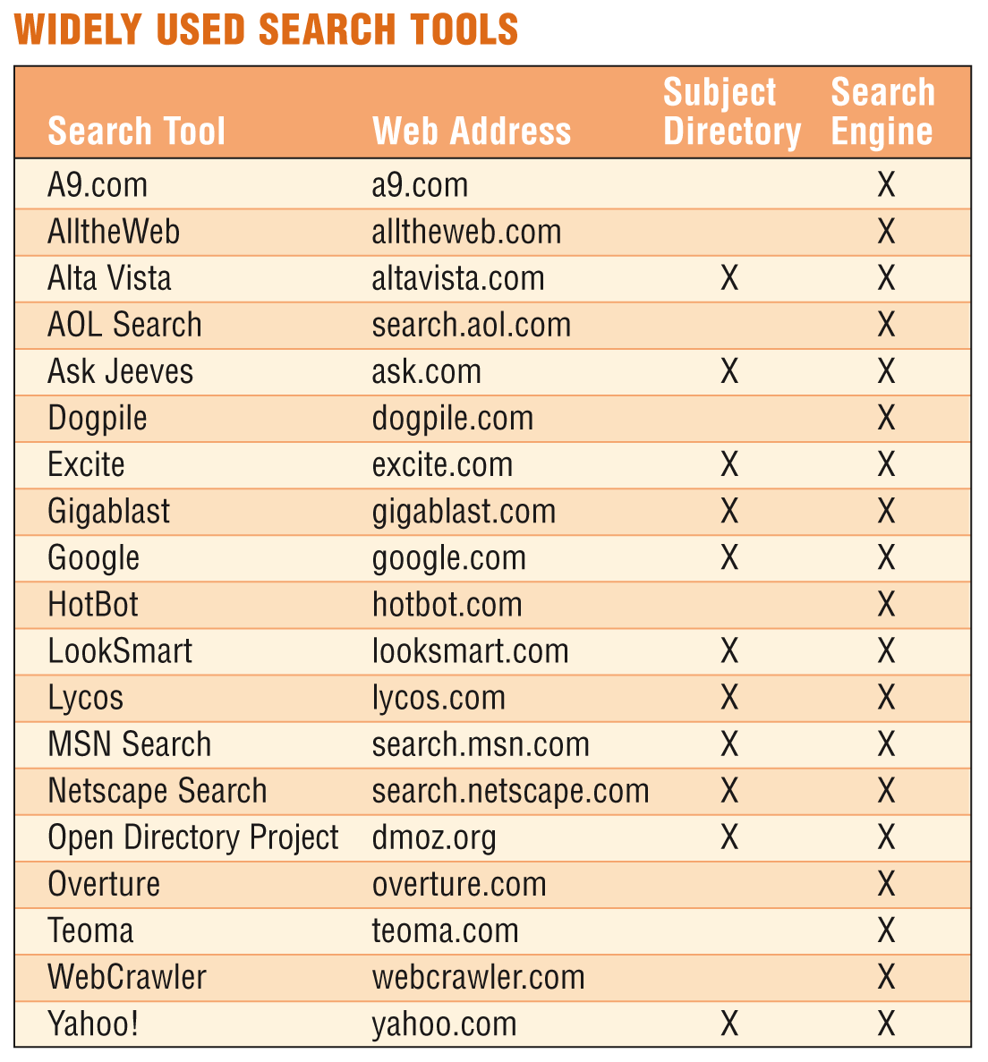
The World Wide Web
What is a search engine?
  Program used to find
  Web sites and Web pages by entering
  words or phrases
  called search text
    Also called a keyword
p. 78 – 80 Fig. 2-10
Next

Slide 22
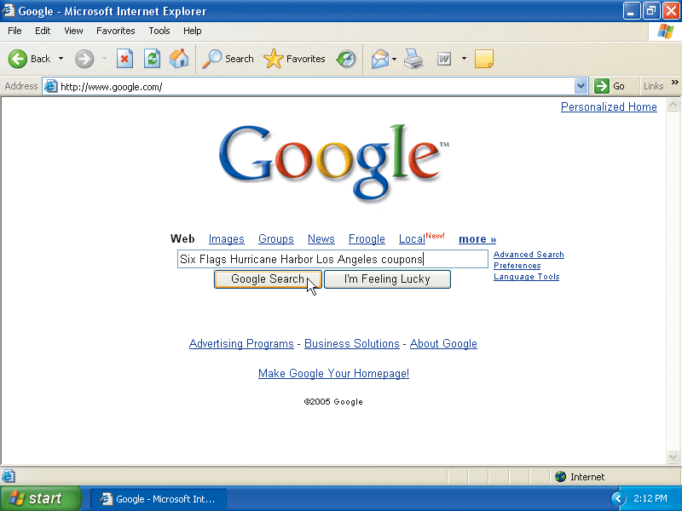
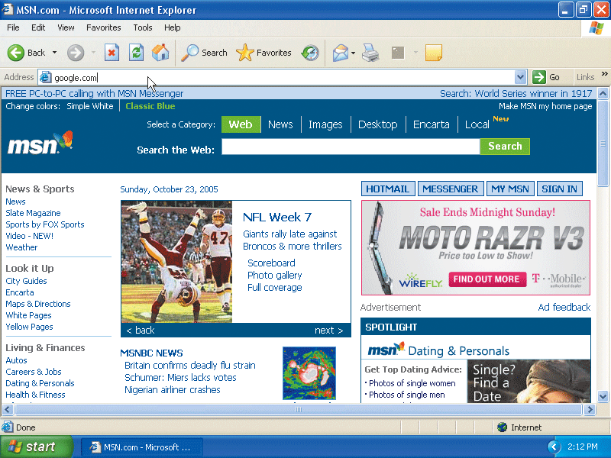
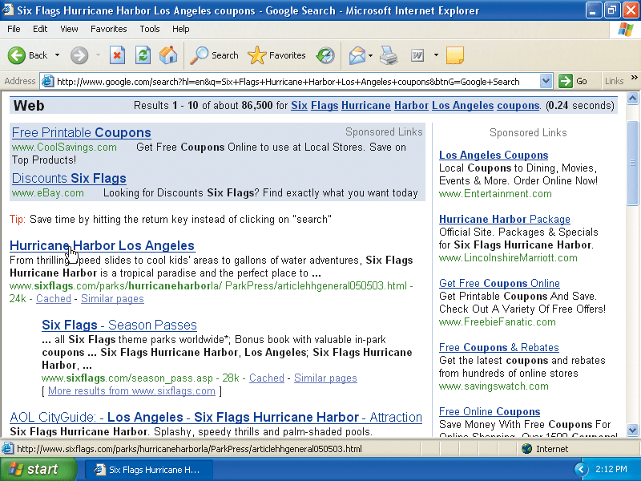
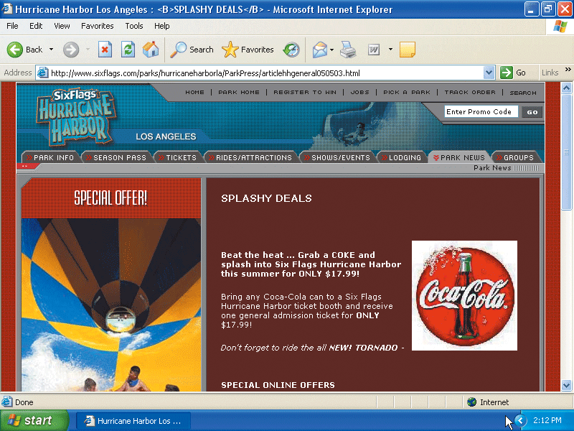
The World Wide Web
What is a hit?
  Any Web site name that is listed as the result of a search
Step 2.
Select type of search you want
to run
Step 1. Go to search engine
Step 3. View hits
Step 4.
Click
link to view
Web site
p. 80 Fig. 2-12
Next

